Slide 1
AutoResearch
March 10, 2026
DSAN 6725: GenAI
Viviana Luccioli

Slide 2
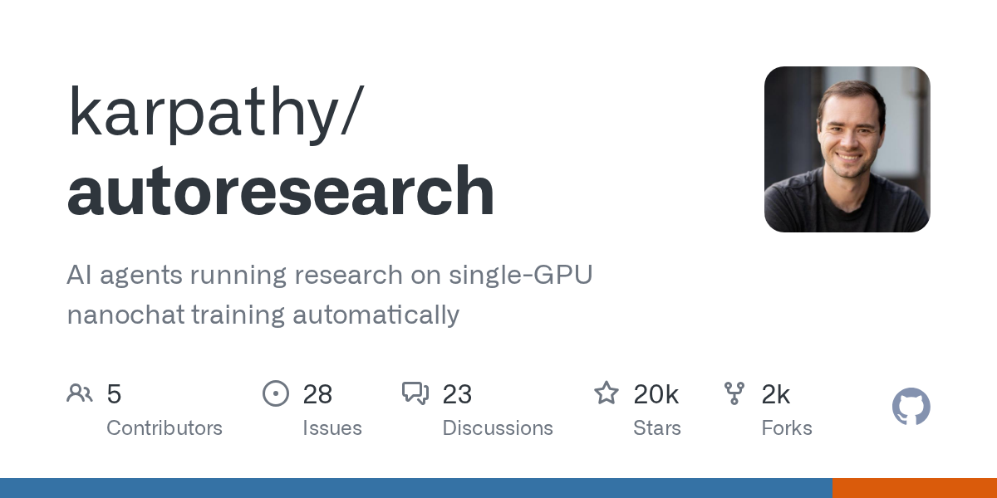

Slide 3
When and Who?
When? → Sunday, March 8, 2026
Who? → Creator: Andrej Karpathy
Former Director of AI at Tesla (Autopilot)
Co-founder and former researcher at OpenAI
Coined the term "vibe coding"
One of the most influential voices in practical AI

Slide 4
Evolution of Agentic AI for Research
2023: Basic code assistants (GitHub Copilot, early ChatGPT)
2024: Agents that can execute multi-step tasks
2025: Autonomous coding agents (Claude Code, Codex)
2026: Autoresearch → agents that run the scientific method autonomously

Slide 5
What is AutoResearch?
A system where AI agents autonomously:
Read their own code
Form a hypothesis for improvement
Modify the code
Run the experiment (5 min)
Evaluate results
Keep or discard changes
Repeat indefinitely
"You wake up in the morning to a log of experiments and a better model." — Karpathy
Notes:
Is autoresearch just autonomous hyperparameter tuning?
It's more than that. Traditional hyperparameter tuning (like grid search or Bayesian optimization) only adjusts numbers — learning rate, batch size, dropout, etc.
Autoresearch can change:
Hyperparameters (yes)
Model architecture (depth, width, attention patterns)
Optimizer choice (switch from AdamW to Muon)
Initialization strategies (Kaiming, Xavier)
Normalization schemes (LayerNorm, RMSNorm)
Basically any code in the training file
So it's closer to autonomous ML research than just tuning knobs.

Slide 6
Experiment
Task: training a small GPT language model on text data
What the agent can change:
Model architecture (depth, width, attention patterns)
Hyperparameters (learning rate, batch size)
Optimizer settings (Muon, AdamW)
Initialization strategies
Normalization choices

Slide 7
How it Works
Three files:
Key constraint: Fixed 5-min training budget per experiment
Metric: Validation bits per byte (val_bpb)
File | Written by | Modified during autoresearch?
prepare.py | Human | No — fixed, never touched
train.py | Human (initial version) | Yes — agent modifies this
program.md | Human | No — instructions for the agent
Notes:
"So how does it actually work? It's surprisingly simple—just three files.
prepare.py — Downloads data, trains the tokenizer, sets up evaluation. This is the "infrastructure" that stays constant.
train.py — A working baseline training script. The model trains, it's just not optimized. This is the starting point the agent improves upon.
program.md — Instructions telling the agent what to do, what metric to optimize, constraints, etc.
Then the agent takes over
Starting from the human-written train.py, the agent:
Reads it
Proposes changes
Tests them
Keeps or discards
Builds up improvements
The agent reads the training code, comes up with an idea—maybe 'what if I change the learning rate?' or 'what if I use a different architecture?'—then it modifies the code, runs a 5-minute training experiment, checks if the validation loss improved, and either keeps the change or throws it away. Then it repeats.

Slide 8
Key constraint: 5 min training budget
Problem: How do you compare experiments fairly?
tiny model → trains fast, may underperform
huge model → trains slow, may be stronger
Solution: Cap every experiment at exactly 5 minutes
Apples-to-apples comparison across any changes
"What's the best model you can train in 5 minutes?"
Incentivizes efficiency
~12 exp/hr
~100+ exp overnight
Results optimized for your specific hardware
Notes:
First, the fixed 5-minute training budget. When you're comparing experiments, you have a problem: a tiny model trains fast, a huge model trains slow. Different batch sizes, architectures, optimizers all affect speed How do you compare them?
Karpathy's solution is to cap every experiment at exactly 5 minutes wall-clock time, so since the start of the new configurations running. This means you're always asking the same question: what's the best model you can train in this fixed time? It makes every experiment directly comparable, and it incentivizes the agent to find efficiency—not just brute-force scale.

Slide 9
Key Metric: val_bpb
Task: Predicts the next word given previous words
Hold out a validation set (text the model never trained on)
Check: what prob did the model give to the actual next word?
Higher confidence in correct answer = better model
Convert probability → bits using information theory
"The cat sat on the ___"
→
model assigns probs to every
possible next word
Confidence | Bits
100% | 0
50% | 1
1% | 6.6
Lower bits = better predictions
Notes:
Second, the metric: validation bits per byte. The model's job is to predict the next word. We measure how confident it was in the correct answer, then convert that to bits using information theory. Lower bits means higher confidence means better predictions. The 'per byte' part normalizes for different tokenization schemes, so you can compare models even if they use completely different vocabularies.
Lower bits = better predictions
"Per byte" → normalizes across different tokenizers/architectures
Result: One universal metric, no matter what the agent changes
Lower bits = better predictions
"Per byte" → normalizes across different tokenizers/architectures
Result: One universal metric, no matter what the agent changes

Slide 10
Results
Overnight run: 126 experiments, loss dropped from 0.9979 → 0.9697
Two-day run: ~700 autonomous changes
Outcome: Found ~20 improvements that transferred to larger models
Impact: 11% efficiency gain on "Time to GPT-2" benchmark
The agent caught mistakes Karpathy missed in 20 years of manual work

Slide 11
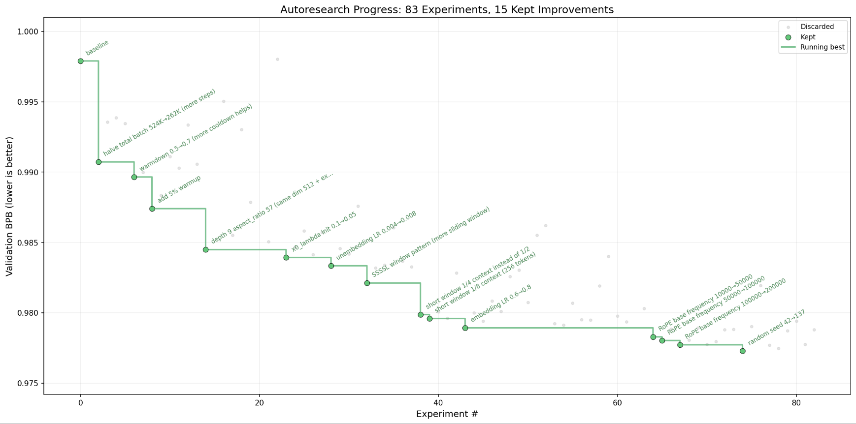

Slide 12
The Swarm Effect: Real Use
Hyperspace AI distributed autoresearch across 35 agents overnight (Karpathy only ran 1):
333 experiments ran unsupervised
Agents shared discoveries via gossip protocol
Hardware diversity led to different strategies
In 17 hours: rediscovered ML milestones that took humans 8 years
Notes:
What the Gossip Protocol Is
The article mentions it's called GossipSub — a peer-to-peer communication protocol where agents share their discoveries with each other in real-time.
From the article:
"Using the GossipSub protocol, agents shared their wins in real-time. When one agent found that Kaiming initialization dropped loss by 21%, the idea spread through the network like a digital virus. Within hours, 23 other agents had incorporated the discovery into their own hypotheses."
How it works (conceptually)
Think of it like actual gossip:
Agent A discovers something useful
Agent A tells a few neighboring agents
Those agents tell their neighbors
Information spreads across the whole network
No central server required — it's decentralized, so agents just "talk" to nearby peers and information propagates organically.

Slide 13
Conclusion
"We are no longer just coding models; we are seeding ecosystems that learn while we sleep."
Autoresearch represents a fundamental shift:
AI applying the scientific method autonomously
Research becoming an evolutionary process
Humans moving from "doers" to "directors"
This could apply to anything with a clear metric: marketing (conversion rate), drug discovery (binding affinity), game AI (win rate), etc.
Notes:
The bottleneck shifts from:
Coding ability → Defining good constraints
Running experiments → Designing experiment spaces
Human hours → Compute hours

Slide 14
Thank you!
Viviana Luccioli

